Slide 1

Stock Market Analysis
(P319-Group 1)
Mentor : Kurnal
Group Members
VALLARASU M
MAYUR SUDHIR CHAVHAN
GANGADHAR B AMBIGER
AJAY KUMAR DAGAR
RAM KAKARLA
VISHWANATH BALKRISHNA JOSHI
RUGVED ANIL CHAUDHARI

Slide 2
Introduction
Comprehensive Insight: Provide a thorough understanding of major companies' stock market performance through detailed analysis.
Pattern Recognition: Identify and highlight patterns, trends, and anomalies in stock behavior over time.
Informed Decision-Making: Equip stakeholders with actionable insights for making informed decisions on stock purchases, sales, and holdings.
Contribute to Predictive Models: Contribute to the development of predictive models, enhancing the ability to anticipate market movements and formulate effective long-term investment strategies.

Slide 3
Average Daily Trading Volume
Uniform Trading Activity: All stocks are around 5.5 million shares, indicating consistent and substantial trading interest across these major tech stocks.
High Liquidity: Similar ADV values suggest high liquidity. This is advantageous for investors, implying easy buying or selling without significant price impact.
Market Popularity: The relatively high ADVs for these tech giants signify widespread investor interest, attributed to strong market presence, financial performance, and overall confidence in these companies.
Most Volatile Stocks
Higher Volatility Stocks: Microsoft , Apple and Amazon have beta values slightly above 1 which indicates that stocks are more volatile and their prices tend to move more significantly in response to market fluctuations. Investors in these stocks may experience relatively larger price swings compared to the overall market.
Market-Aligned Volatility: Google has a beta exactly at 1 means volatility aligns closely with the market. Investors can expect price movements in GOOGL to be in line with the broader market.
Lower Volatility Stock: Facebook has a beta slightly below imply FB is considered relatively less volatile, suggesting that its stock price may not react as strongly to market movements. Investors in FB might experience somewhat smaller price fluctuations compared to the overall market.

Slide 4
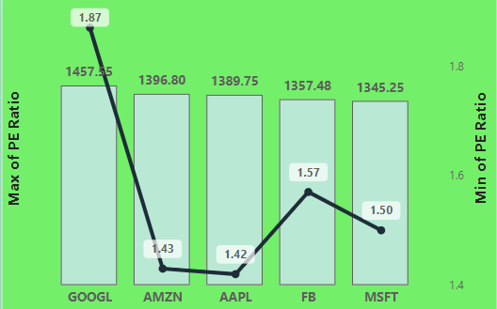
Stocks with Highest Dividend and Lowest Dividend
Highest Dividend Amount:
Microsoft (MSFT) stands out with the highest dividend sum at $3011, signaling strong returns for investors.
Emphasizing the significance of absolute dividend amounts is crucial as it provides a tangible measure of the financial rewards a shareholder can receive.
Lowest Dividend Amount:
Alphabet Inc. (GOOGL) demonstrates the lowest dividend amount, reflecting a strategic focus on reinvesting profits for future growth.
Lower dividends in the context of growth investing suggest that companies like GOOGL prioritize using earnings for innovation and expansion rather than immediate payouts to shareholders.
Stocks with High and Low P/E Ratios
High P/E Ratios: All stocks exhibit extremely high maximum P/E ratios, indicating that investors are willing to pay a premium for expected future earnings growth. This suggests a high level of confidence in the companies' ability to deliver robust financial performance and sustained growth.
Low P/E Ratios: The minimum P/E ratios are exceptionally low, suggesting potential opportunities for value investors. A low P/E ratio can indicate that the market values the stocks relatively less compared to their earnings, potentially signaling undervaluation and presenting an attractive entry point for investors seeking value-oriented opportunities.

Slide 5
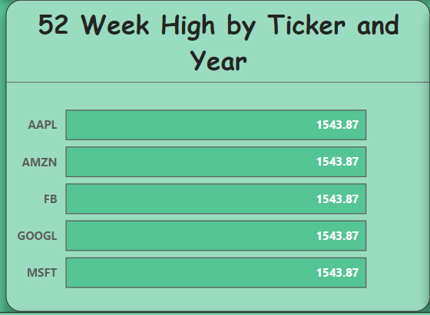
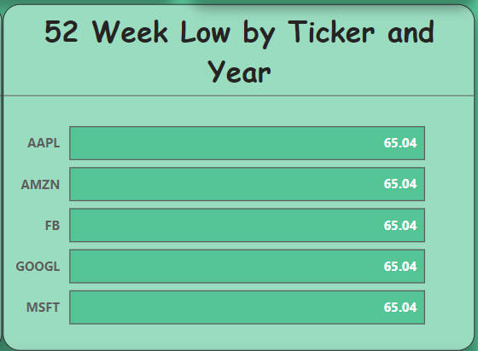
Stocks with Highest Market Cap
Stability and Liquidity: These mega-cap stocks offer stability and high liquidity in the market, making them attractive to risk-averse investors seeking consistent performance.
Limited Growth Opportunities: Due to their size, the potential for rapid growth is limited compared to smaller, high-growth stocks, but their steady performance is favored by those prioritizing reliability over aggressive growth.
Market Dominance: Collectively, these companies dominate the market, influencing overall market sentiment and indices, reflecting their pivotal role in shaping the broader economic landscape.
Diversification: Their inclusion in a portfolio contributes significantly to diversification, providing a balance to riskier assets and enhancing overall portfolio stability.
52 Week High And Low:
It refers to the highest and Lowest price at which a particular stock has traded over the past 52 weeks This metric is used by investors and traders to gauge a stock's recent performance and to assess its potential future movements.

Slide 6
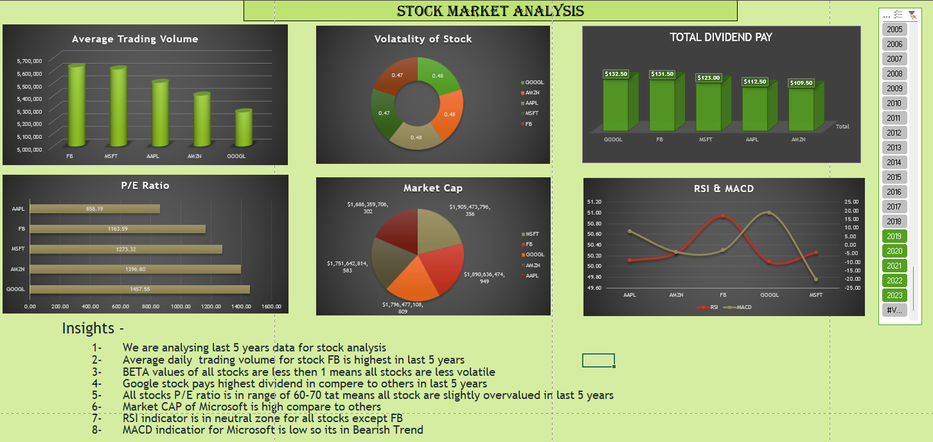
Excel Dashboard

Slide 7
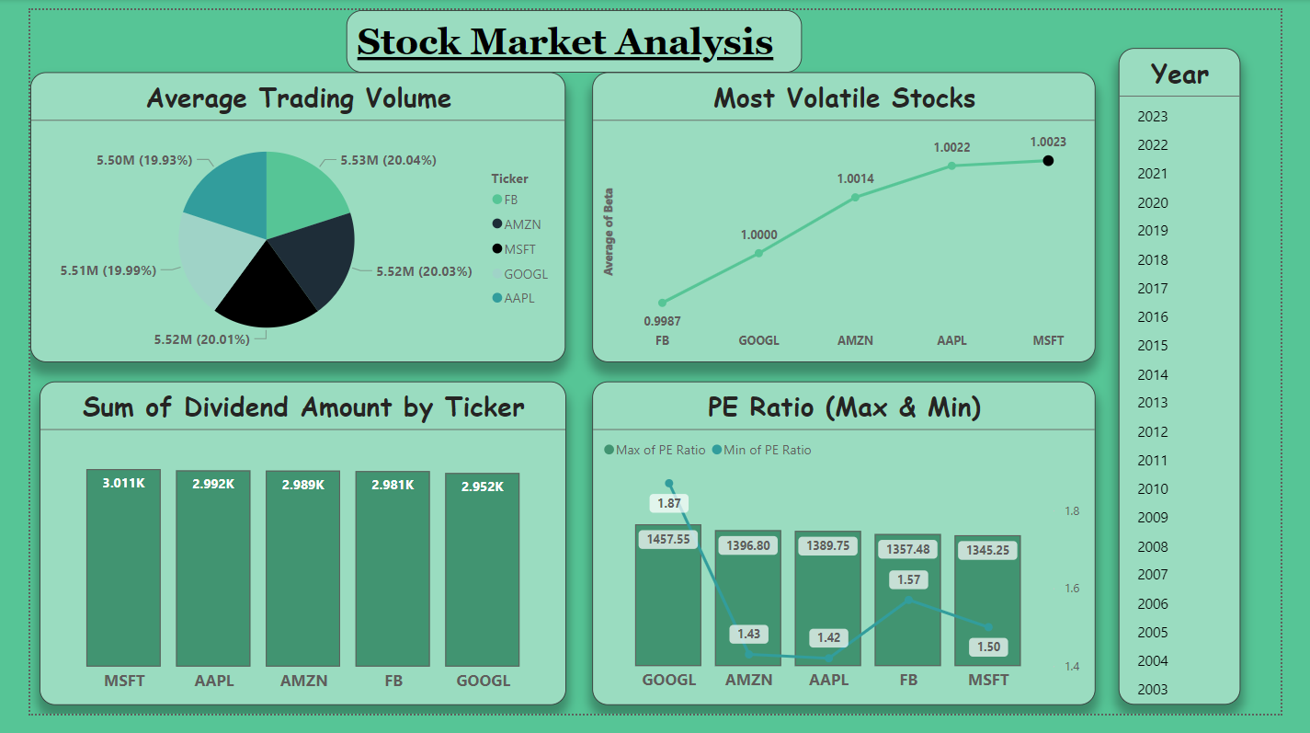
Power BI Dashboard:

Slide 8
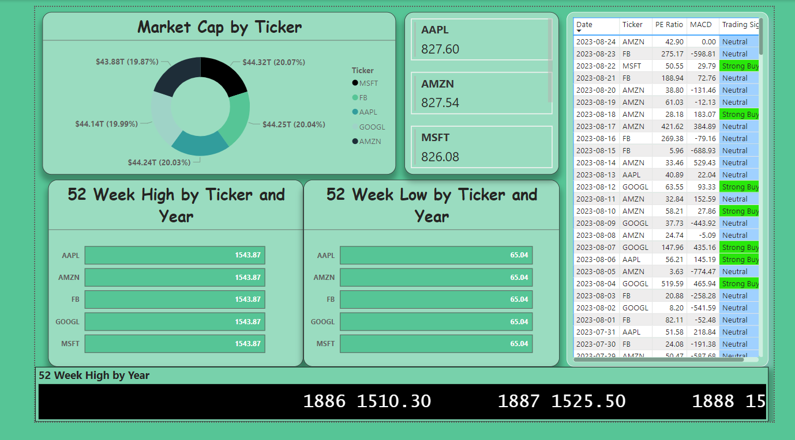

Slide 9
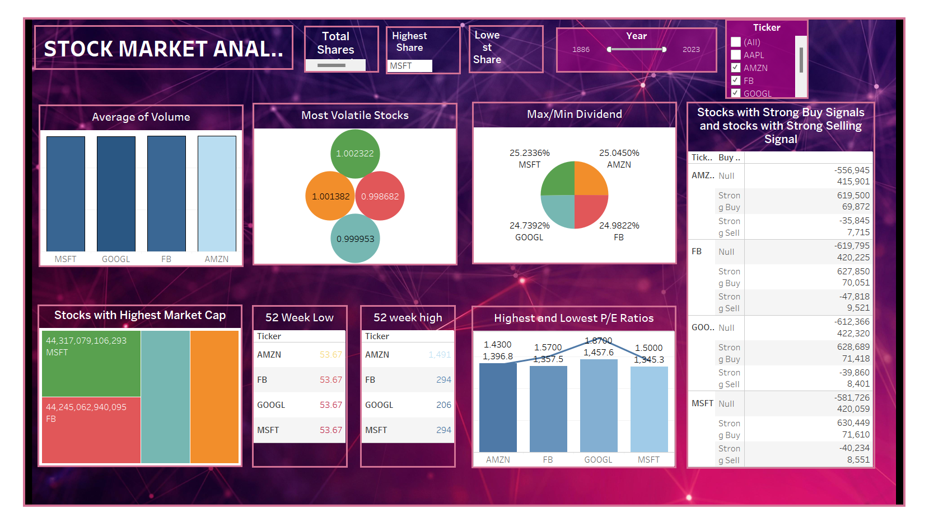
Tableau Dashboard:

Slide 10
Challenges Faced
Understanding the Data:
Unfamiliarity with stock market terminology and data fields posed a significant initial challenge.
Overcoming the learning curve required a thorough understanding of each column's significance and its role in financial analysis.
Choosing the Correct Visualizations:
Selecting the appropriate visualizations for various Key Performance Indicators (KPIs) proved to be a complex task.
Ensuring the visualizations effectively communicated insights without overwhelming the audience with technical details presented a constant challenge.
3.Data Complexity:
The intricacies of stock data, including factors like stock splits and adjusted closes, added analytical complexity.
Gaining a deep understanding of these nuances was crucial for accurate interpretation.

Slide 11
How we overcome
Understanding the Data:
Invested time in learning stock market terminology through educational resources and training sessions.
Adopted an iterative approach, gradually building a solid understanding of each column's role in financial analysis.
Choosing the Correct Visualizations:
Engaged in collaborative discussions with group members to align on the most effective visualizations for each KPI.
Applied principles of data visualization to create clear and concise representations that resonate with a diverse audience.
Data Complexity:
Invested time in training on complex stock data concepts and conducted in-depth research on stock splits, adjusted closes, and other intricate factors.
Developed comprehensive documentation and guides to serve as references for understanding and interpreting complex aspects of stock data.

